Slide 1
Answering public health questions with National Health Surveys Data Analysis
A case study of primary hypertension in NHANES 2013-2014
Jasmine L. Chartrand, 2019

Slide 2
NHANES 2013-2014 National Health and Nutrition Examination Survey
Cross-sectional survey
Observational study from a sample of the population at a specific time
Target population: Resident population of the United States
Sample for the interview: 10,176 persons from 30 different survey locations
Data collected:
Demographics, Questionnaire, Lab Results, Examination, Medication

Slide 3
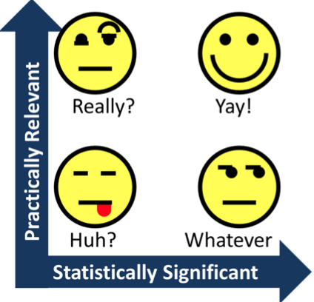
WHY ’HYPERTENSION’?
Hypertension is the medical term for high blood pressure.
In HBP, blood applies too much force against the walls of the blood vessels.
Hypertension is the most common primary diagnosis in the United States
Source: https://emedicine.medscape.com/article/241381-overview

Slide 4
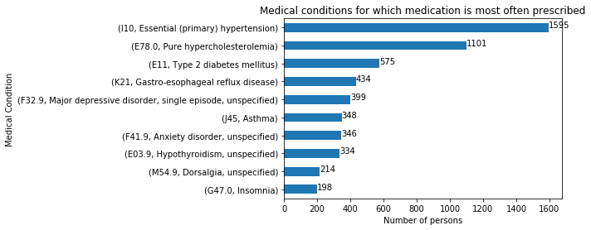
Why ’hypertension’?
HYPERTENSION IN NHANES 2013-2014

Slide 5
QUESTIONS
Q: What are the determinants of hypertension?
Or what are the associated complications? => Simple correlation
(way too many missing values in each column for feature selection!)
Q: Can we identify individuals with hypertension? => CLASSIFICATION
Q: Can we predict the age of onset of hypertension? => REGRESSION
Notes:
Those are common questions in public health
DETERMINANTS vs COMPLICATIONS => inferring causality is out of the scope of this project

Slide 6
Data Acquisition
Through Kaggle
https://www.kaggle.com/cdc/national-health-and-nutrition-examination-survey
All participants are identified by a unique sequence number ‘SEQN’
The scope of this project is limited to the following files and variables
demographics.csv
Age, Gender (M/F), Total Annual Household income ($), Family or Individual income ($)
medications.csv
Reason for use of the medication (ICD10 medical condition code)
questionnaire.csv
All questions!! => 952 variables!
Not all the variables are useful for our topic!

Slide 7
Data Cleaning
Text values
those variables were removed from the dataset because they were out of the scope of the project (i.e. ‘brand of cigarettes’)
all the relevant variables were already coded as numeric values
[7, 77, 9, 99]: missing values or continuous values?
‘Refused to answer’ [value: 7, 77, 777]
‘Don’t know’ [value: 9, 99, 999]
Missing values [value: (blank) or . ]
Statistically significant enough variables
Columns where count > 310 (confidence=0.95, n=1595)
Variables with std() = 0 (variance is 0)
i.e. ‘Do you speak English at home?’ (yes: 1, missing value otherwise)

Slide 8
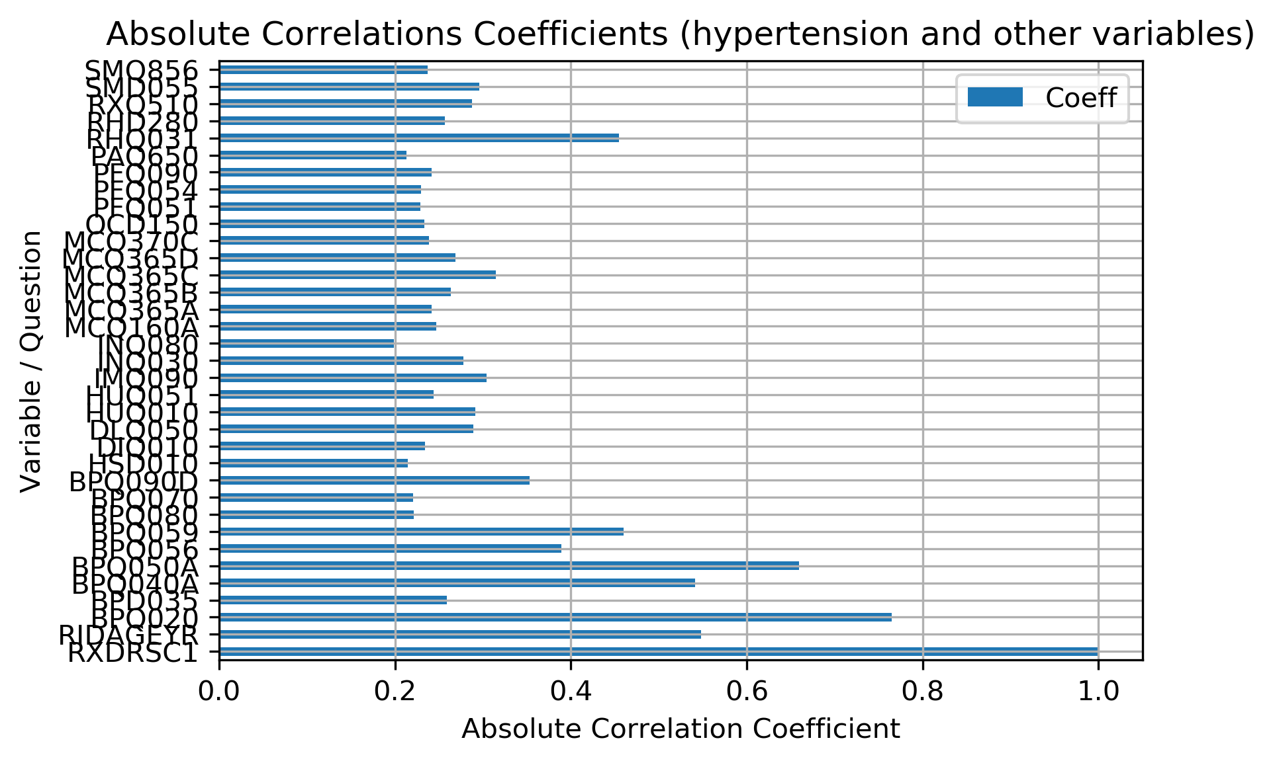
Q: What are the questionnaire variables correlated with hypertension?
Variables with absolute correlation coeff > 0.2 with hypertension
Notes:
This type of graphic (bar chart) was chosen to present all the variables in a condensed format, even though correlations are usually depicted with linear graphics

Slide 9
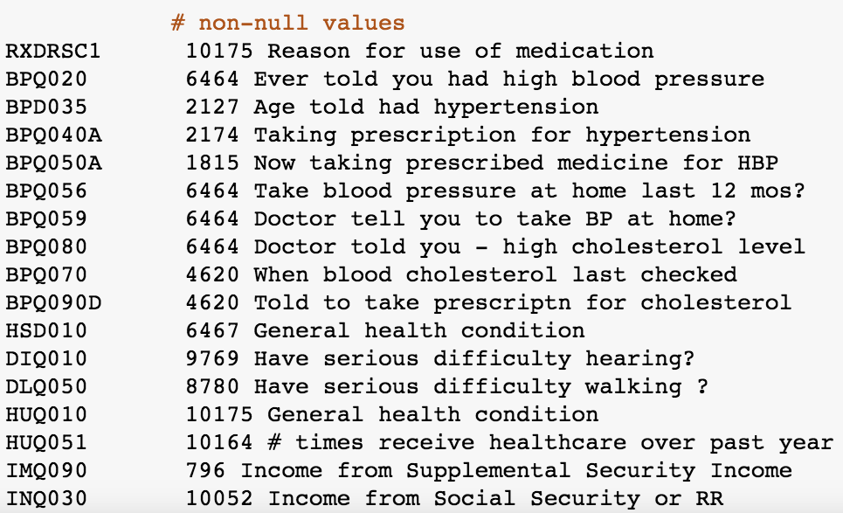
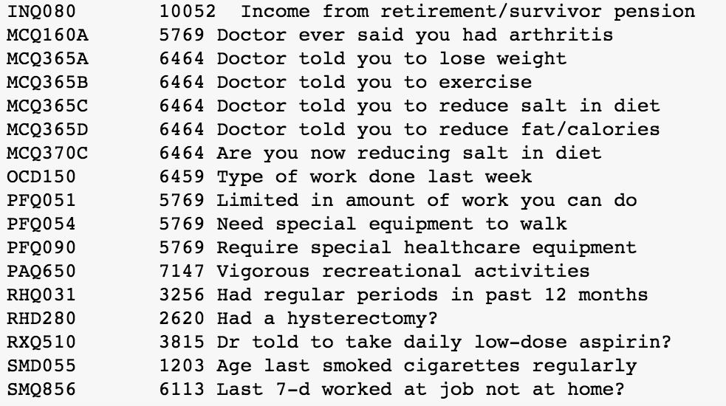
Q: What are the questionnaire variables correlated with hypertension?
Notes:
Even with simple correlation, selected variables are still very relevant!

Slide 10
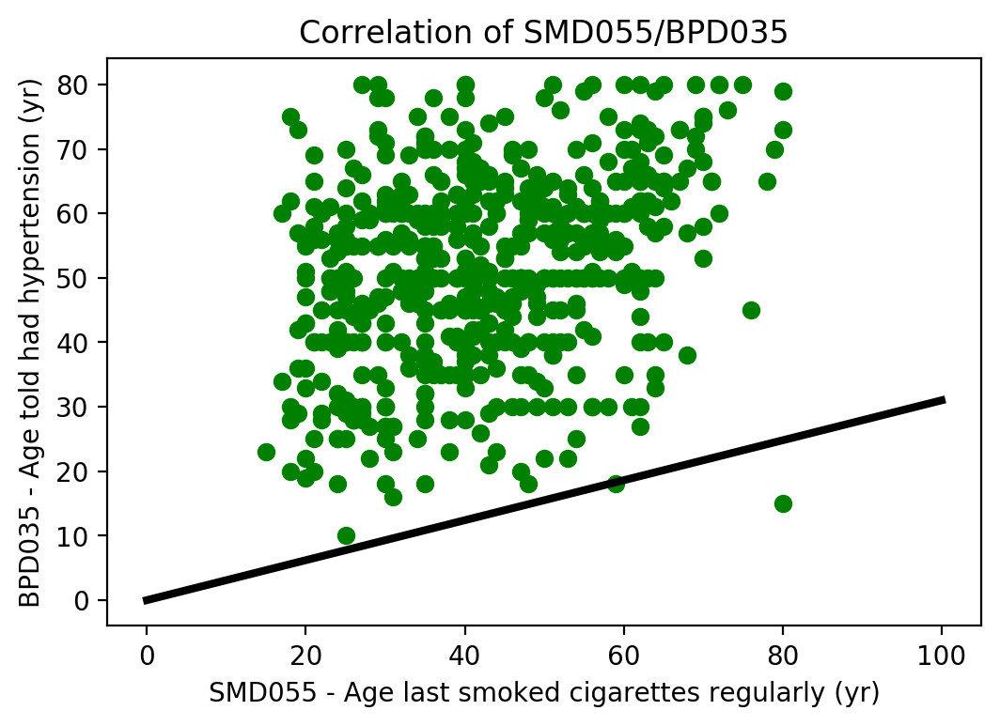
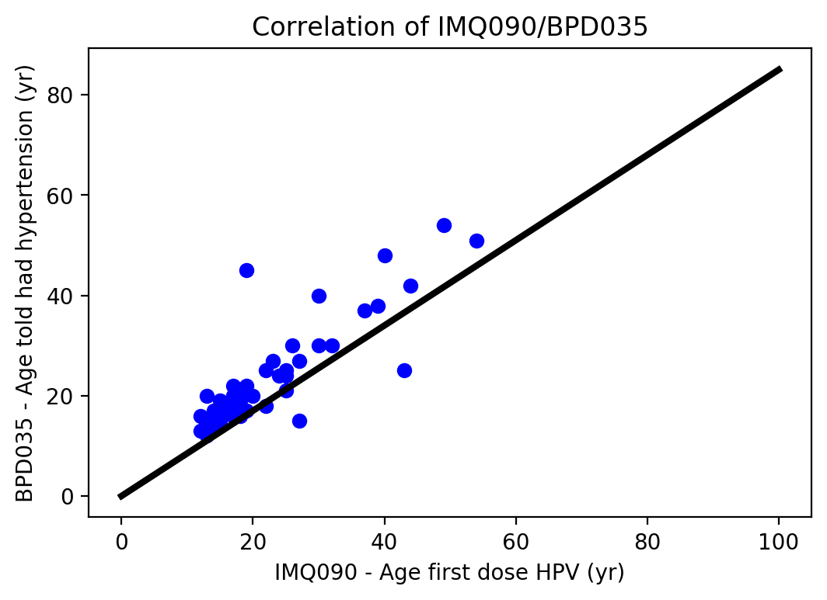
Exploring correlations with age-related variables
C = 0.85
C = 0.31
N = 576
N = 46

Slide 11
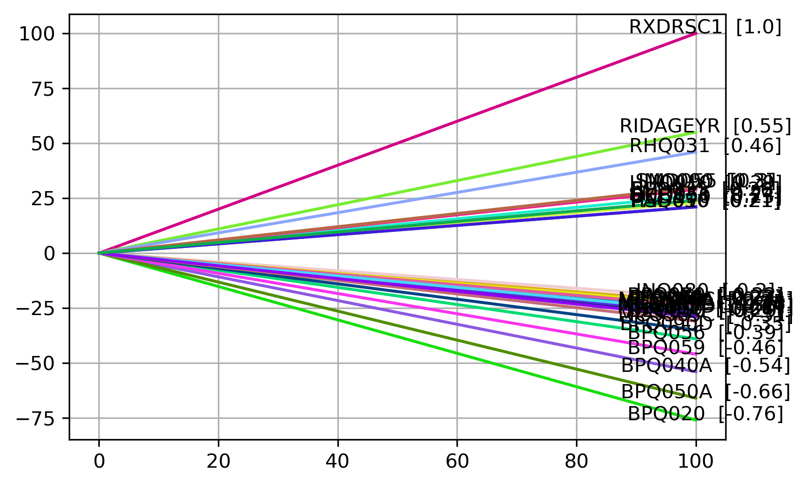
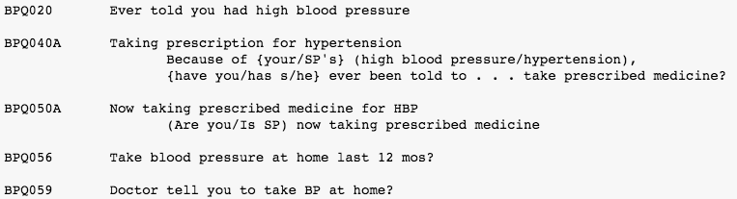
Exploring correlations with BLOOD PRESSURE variables
Notes:
Unsurprisingly, some of the most correlated items are related to blood pressure.. However, take note of the formulation of some of the questionnaire variables

Slide 12
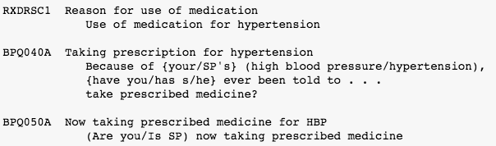
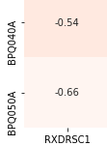
Some HEALTH data issues
Compliance
Does the person follows the doctor’s recommendations?
Self-reported items
Does the person respond truthfully?
Observations at a very specific time
Chronic VS Episodic disease
Correlation Coefficients

Slide 13

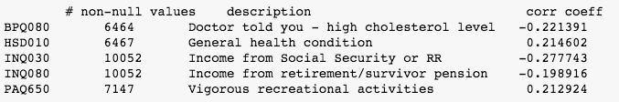
Q: Can we identify individuals with hypertension?
Assuming we do classify an individual as having/not having hypertension only based on this target
We built our model on these arbitrary variables
These questionnaire variables are not too obviously related to blood pressure, and they are broad enough
Notes:
-would be too easy to build a model out of the previous blood pressure-related variables
-those selected variables are broad enough

Slide 14
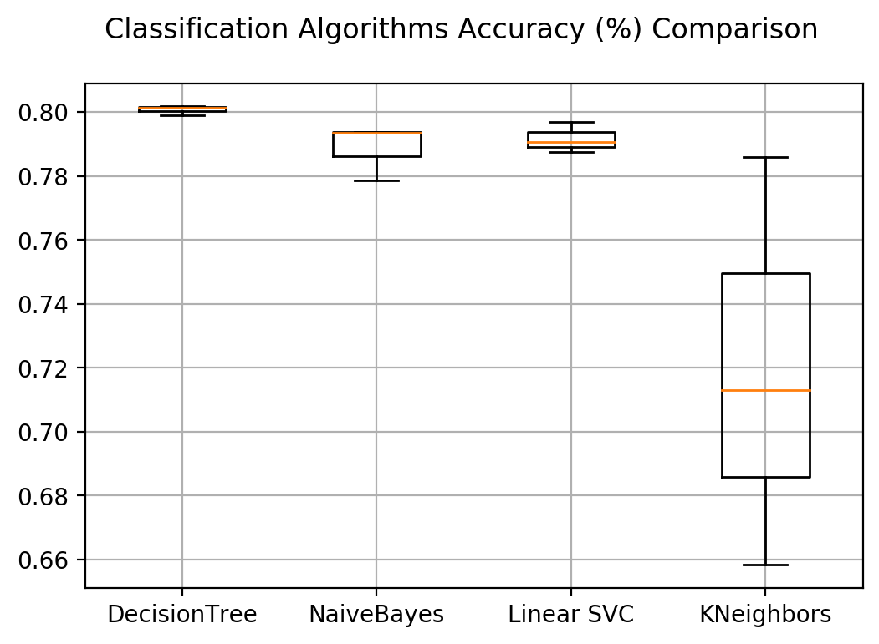
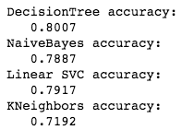
Q: Can we identify individuals with hypertension?
(CONT’D)

Slide 15
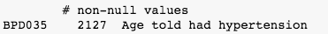
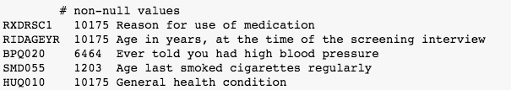
Q: CAN WE PREDICT THE AGE OF HYPERTENSION DIAGNOSIS?
Target variable for regression
We built our regression model on these arbitrary variables
These questionnaire variables may give some indications of age, and they are correlated to hypertension

Slide 16
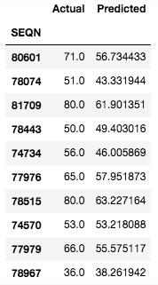
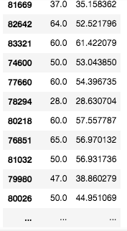
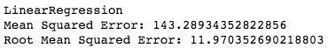
Q: CAN WE PREDICT THE AGE OF HYPERTENSION DIAGNOSIS?
(CONT’D)
Difficult to measure the performance!
RMSE is 11.97, which does makes sense…
The predictions seem to be more or less accurate and precise.

Slide 17
CONCLUSION
Challenges:
Too many variables (~ 900 variables in the questionnaire dataset)
= > did not check the description of all the variables
Many variables were not relevant to our topic (hypertension)
Lots of missing data:
Column had ~ 60% of their data values filled at most!
Few overlaps among columns
Reliability of self-reported data?
Contradictory or Incomplete information
(i.e. Medication is prescribed for hypertension according to the medication records, but the participant does not report taking medication for hypertension)

Slide 18
CONCLUSION
(CONT’D)
Questions:
Q: What are the questionnaire variables correlated with hypertension?
Blood pressure-related variables, some cholesterol variables, general health, occupational difficulties (hearing/walking), physicians recommendations (weight, exercise, diet), income source, etc.
Q: Can we identify individuals with hypertension?
The accuracies of the classification models were ~ 78-80%
Q: Can we predict the age of hypertension diagnosis?
The linear regression performance in terms of root mean squared error (RMSE) was ~ 11.97 years

Slide 19
THANK YOU!!! ☺
ANY QUESTIONS?
CONTACT
Jasmine L.-Chartrand
jasmine.leblond-chartrand@concordia.ca
https://github.com/jleblond/NHANES_data_analytics

